Slide 1

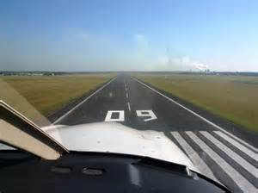
2. Naming of Runway
Runways are named by a number between 01 and 36, which is generally the magnetic azimuth of the runway's heading in decadegrees:
For instance:
A runway numbered 09 points east (90°), and it is designated as "Runway 09".
magnetic azimuth 磁方位

Slide 2
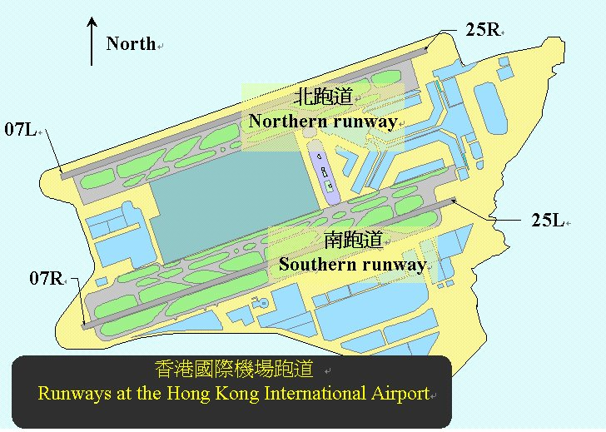
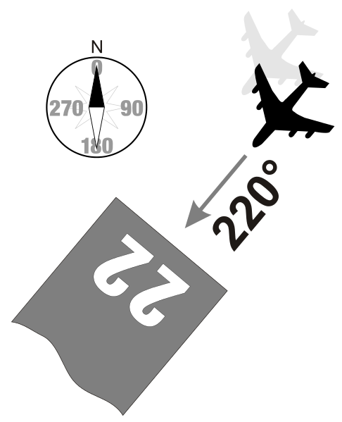
2. Naming of Runway
A runway can normally be used in both directions, and is named for each direction separately:
e.g., "runway 33" in one direction is "runway 15" when used in the other. The two numbers always differ by 18 (= 180°).

Slide 3

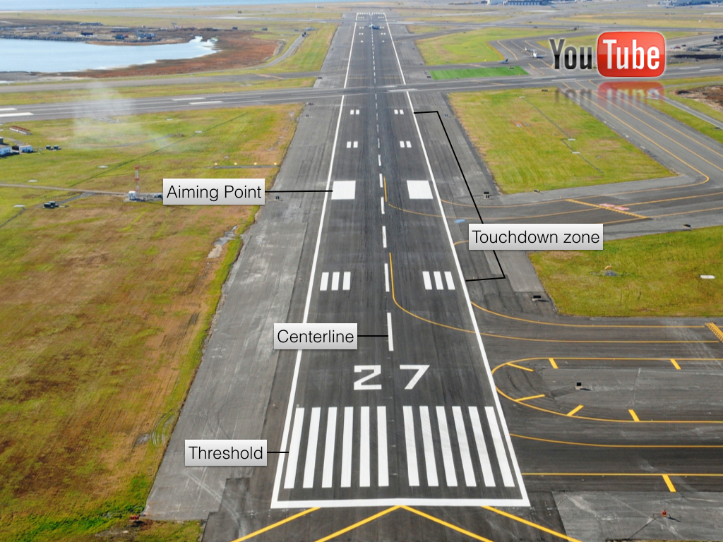
3. Sections of a runway
下滑点
接地区域
中线
跑道入口

Slide 4
3. Sections of a runway
runway threshold
The runway thresholds are markings across the runway that denote the beginning and end of the designated space for landing and takeoff under non-emergency conditions.
A displaced threshold is a runway threshold located at a point other than the physical beginning or end of the runway. The portion of the runway so displaced may be used for takeoff but not for landing.
runway threshold 跑道入口
displaced threshold内移的跑道入口

Slide 5
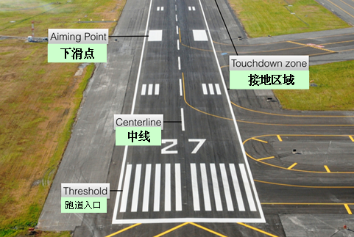
3. Sections of a runway
touchdown zone
The touchdown zone is where the aircraft’s wheels make contact with the ground during landing.
touchdown zone 接地区域

Slide 6

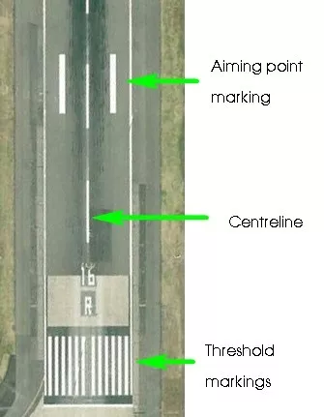
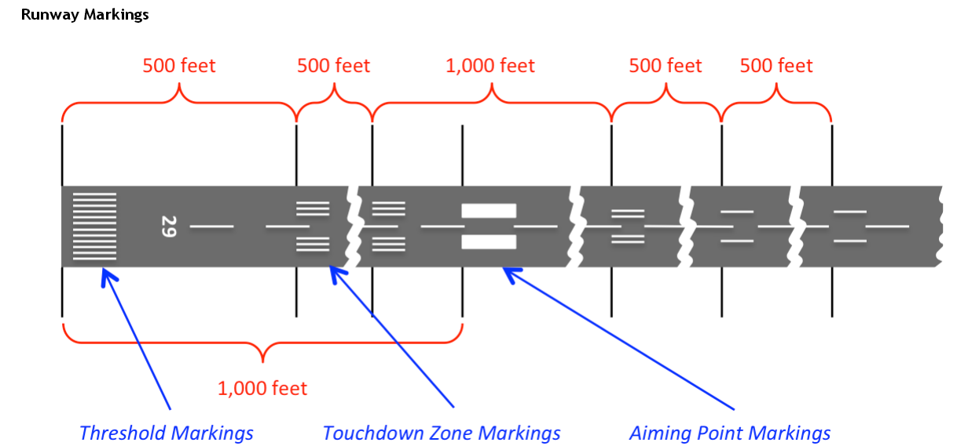
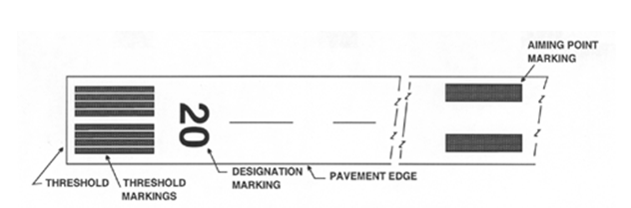
3. Sections of a runway
runway markings
runway markings 跑道标志

Slide 7
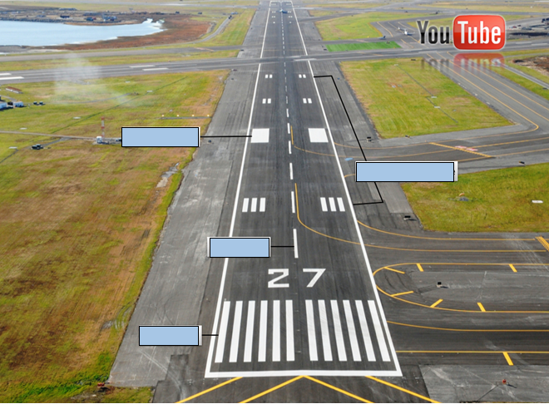
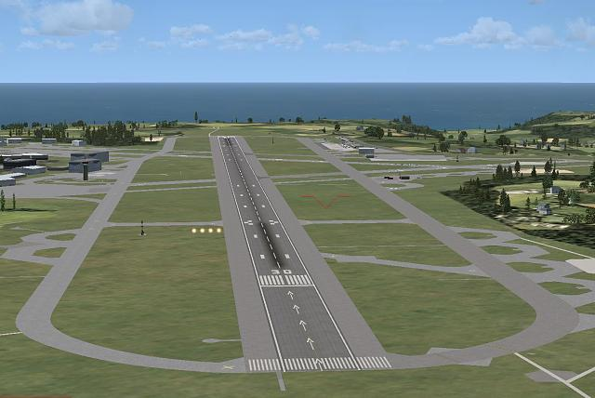

Slide 8

5. Length of Runway
Local conditions to be considered:
Elevation(海拔)
Temperature
runway slope
Humidity
Surface characteristics

Slide 9
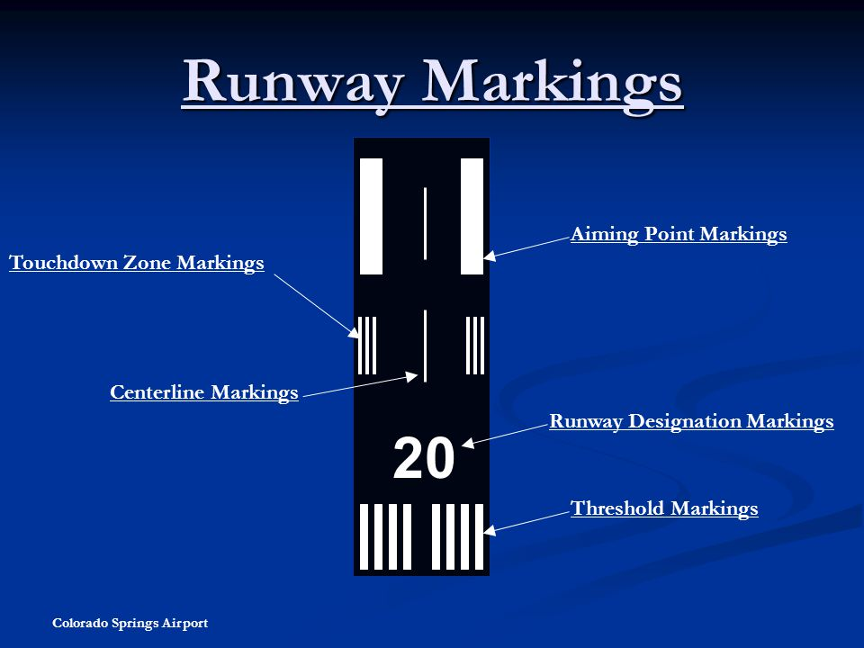
B
A
C
Runway name
D

